Slide 1
Augmented Random Search
Presenters:
Gautam Suryawanshi
Prajit Krisshna Kumar
Reinforcement Learning – CSE 510

Slide 2
Model free RL algorithms
Gives solutions for controlling dynamical systems without need of actual physical models
This systems successfully learn to play video games or games like GO and chess
Not deployed in real world physical systems

Slide 3
Problems
We need to find a best method
Studies indicated that several RL methods are not robust to changes in parameters.
Small change affects them a lot
Is not trustable to deploy in real world that needs to control 100s of motors

Slide 4
New directions
Evolution Strategies – derivative free optimization method, parallelized training
Natural policy gradients for training linear policies
ARS is combination of both

Slide 5
History
Published in March, 2018 by a team from University at California, Berkeley
ARS is enhanced version of Basic random search
BRS:
Policy = π𝜃
We add +𝛎𝜹 and -𝛎𝜹 to existing policy(v<1 and it is noise) 𝜹 is random number from normal distribution
Apply the actions and get the rewards
Update the policy using 𝜃ʲ⁺¹ = 𝜃ʲ + 𝝰.Δ
Where Δ = 1/N * Σ[r(𝜃+𝛎𝜹) - r(𝜃-𝛎𝜹)]𝜹

Slide 6


Slide 7
Motivation
One of the most mind-blowing algorithms in reinforcement learning,
Up to 15 TIMES FASTER than other algorithms with higher rewards in specific applications.
Does not require Deep Learning.

Slide 8
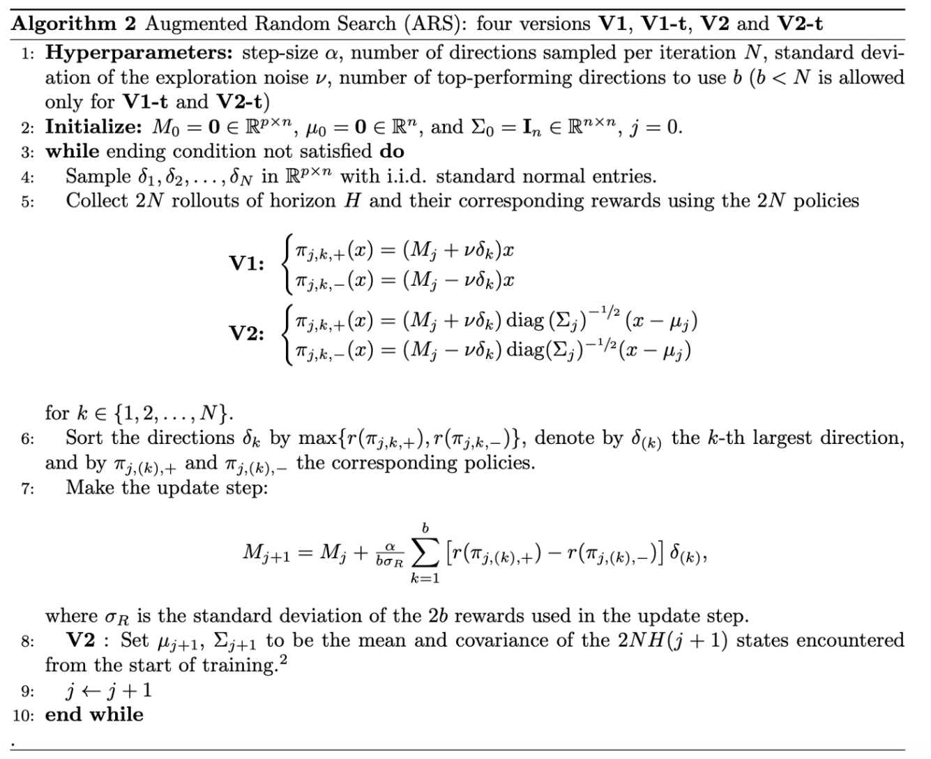
Algorithm

Slide 9
Simplified Explanation
Add Random Noise(𝛿) to the weights ϴ.
Run a test.
If reward improves keep the weights.
Otherwise discard.

Slide 10
Method of Finite Differences
Generate a random noise(𝛿) of the same shape of the weights (ϴ)
Clone two versions of our weights.
Add the noise to ϴ[+], subtract from ϴ[-]
Test both versions for one episode each, collect r[+] , r[-]
Update the weights ϴ += α(r[+] – r[-]). 𝛿
Test and repeat for maximum performance.

Slide 11
Training Loop
Generate num_deltas deltas and evaluate positive and negative.
Run num_deltas episodes with positive and negative variations.
Collect rollouts as (r[+],r[-],delta) tuples.
Calculate the standard deviation of all rewards.
Sort the rollouts by maximum reward and select the best num_best_deltas rollouts.
Step = sum((r[+] – r[-])*delta ), for each best rollout.
Theta += learning_Rate/(num_best_deltas*sigma_rewards)*step
Evaluate: play an episode with the new weights to measure improvement.

Slide 12
Results
Episode 1

Slide 13
Results
Episode 1000

Slide 14
Comparison with DDPG
At 1000 episode

Slide 15
Comparison with PPO
At 1000 episode

Slide 16
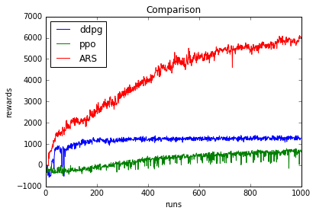

Slide 17
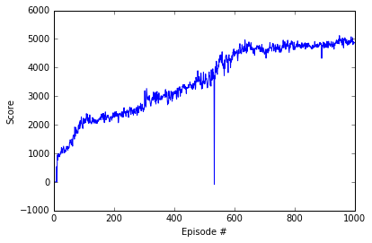
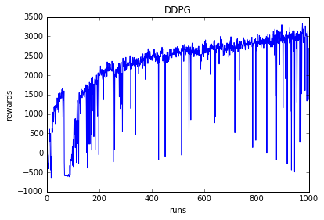
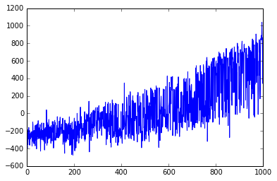
Comparing rewards
ARS
DDPG
PPO

Slide 18
Time for ARS to run : 5630 seconds
Time for PPO to run : 2142 seconds
Time for DDPG to run : 9270 seconds

Slide 19
Humanoid

Slide 20
Bipedal Walker

Slide 21
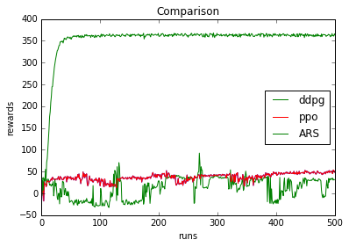
Results of Swimmer

Slide 23
References
https://towardsdatascience.com/introduction-to-augmented-random-search-d8d7b55309bd
https://arxiv.org/pdf/1803.07055.pdf)
Codes for DDPG and PPO from https://github.com/Anjum48/rl-examples/

Slide 26
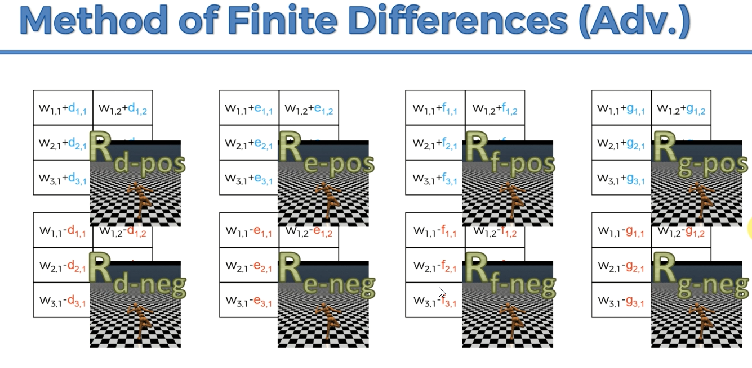

Slide 27
